Slide 1














1
Analyzing Market Trends, Workforce Dynamics, and Customer Loyalty for Growth in a Hardware
and Electronics Retail Business
BDM capstone Project
Submitted by
Name:Aaditya Dattaraj Sawant
Roll number:23f3001416(DS)

Slide 2
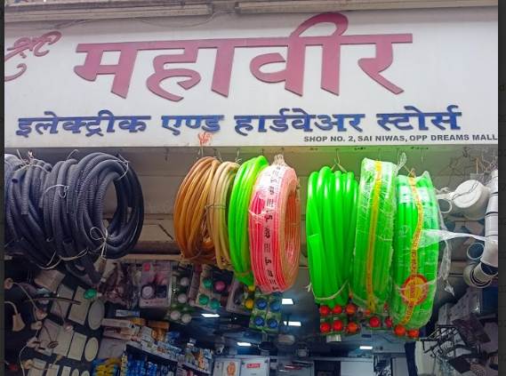
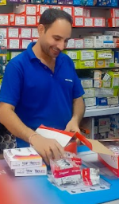

Organisation Background
2
Mahavir Enterprise is a well-known hardware and electronics shop located in Bhandup, Mumbai, founded by Vijay Singh in 2004.
Mr. Singh, after five years of industry experience, started the business with a small capital, focusing strongly on trust and customer relationships.
Early growth was supported by business associates and friends, helping Mahavir Enterprise build a solid reputation in the local market.
Initially a B2B retailer, the company grew during the COVID-19 pandemic by expanding into the offline B2C segment as well.
Today, Mahavir Enterprise is known for its quality products and customer-trust, aiming to expand its reach across northeast Mumbai

Slide 3




Problem Statement
3
🔹 Variable Demand
The venture deals with both modern and outdated hardware components due to mixed customer requirements from nearby modern apartments and traditional slum areas.
Frequent demand shifts make inventory management difficult, leading to delays, unavailability, and customer dissatisfaction.
Balancing stock for fast-moving new items and slow-moving old parts is a constant operational challenge.
🔹 Labor Challenges
The shop operates with only four unskilled workers managing the entire operations, handling long working hours (10–15 hours daily).
Exhaustion, occasional absenteeism, and lack of backup staff often disrupt day-to-day business.
Hiring and retaining skilled workers is tough due to the technical knowledge required and better opportunities elsewhere.
In year 2022 employees were given Mondays as a holiday but it led to serious profit and sale decrement , revoking back the policy
🔹 Customer Loyalty
A strong existing B2B net
work built on years of trust provides stability but also causes over-reliance on a limited set of clients.
Difficulty in expanding the B2C (retail) segment limits business growth and revenue diversification.
Finding and building trust with new customers remains a slow and difficult process compared to maintaining existing business relationships.

Slide 4


Data Collection Process
4
Primary Data Sources:
All data used in this project was collected directly from Mahavir Enterprise’s internal records, making it primary data.
Types of data collected:
Attendance Logs: Monthly working hours for each employee (Jan 2021–Dec 2024).
Sales Records: Quarterly sales data for both traditional (old) and modern (new) product categories, segmented by B2B and B2C channels.
Financial Invoices: Monthly gross profit margins and purchase histories.
Data authenticity was ensured through:
Direct access to original registers and sales sheets.
Owner’s written authorization, photographs, and video documentation of the data collection process.
Collection Steps:
Multiple meetings with the business owner and staff to clarify business problems and identify relevant data.
Data was digitized and organized into structured spreadsheets for analysis.
Data cleaning included removing duplicates, correcting inconsistencies, and handling missing values using mean imputation where necessary
Data extraction from logs
Digitization
Data cleaning and validation
Meetings with owner

Slide 5




Methodology
5
🔹 Descriptive Statistics & Visualization
Calculated mean, median, and variance to summarize key trends in sales and workforce data.
Used a single line graph to show sales trends over time, highlighting seasonal and policy impacts.
🔹 Time Series Forecasting
Applied Holt-Winters Exponential Smoothing to model both trend and seasonality to validate and forecast in quarterly sales.
Chosen over simpler models (like moving average) because it accurately captures regular fluctuations and long-term growth, which is essential for retail planning.
Outperforms simple moving averages and basic exponential smoothing, which cannot handle seasonal effects.
More interpretable and easier to implement for business users than complex models like ARIMA or neural networks, while still providing robust, actionable forecasts.
🔹 Model Evaluation
Used RMSE (Root Mean Square Error) to measure forecast accuracy; penalizes large errors, making it more reliable for business decisions.
Achieved a low average RMSE of 7.28 units, confirming high reliability and strong predictive performance.
🔹 Tools Used
Python (Pandas, Statsmodels, Scikit-learn, Matplotlib, Seaborn): For advanced data cleaning, modeling, and visualization, time series modeling, especially Holt-Winters forecasting..
Excel & Google Sheets: For initial data entry, quick checks, and sharing with stakeholders.

Slide 6
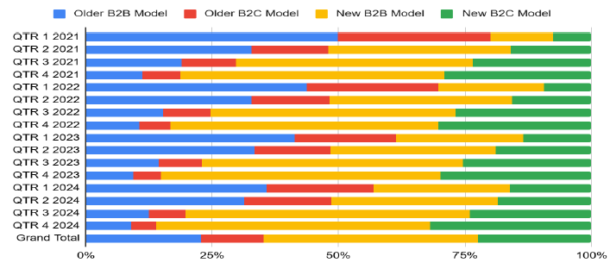
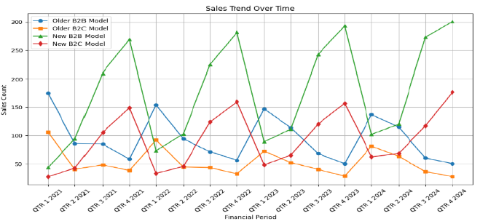
Results and Findings
6
This fully stacked bar chartchart best for comparing sales composition changing over time displays how the sales mix between older and newer product models, and between B2B and B2C, has changed each quarter from 2021 to 2024.
The share of older models (both B2B and B2C) consistently shrinks, while new B2B and especially new B2C segments expand, quarter by quarter.
The growing dominance of new product sales, particularly in the B2C segment, signals a clear shift in market preference and highlights where future inventory and marketing efforts should be focused.
This line chart traces the sales counts for each business model across quarters, making it easy to spot rises, falls, and turning points over time.
A sharp dip is visible in early 2022, coinciding with the “Monday-off” policy, followed by a strong recovery as the policy was reversed, and a pronounced upward trend for new B2B and B2C models.
The pattern demonstrates that operational decisions and market adoption of modern products have a direct and measurable impact on overall business growth, with new models driving the recovery and expansion.

Slide 7
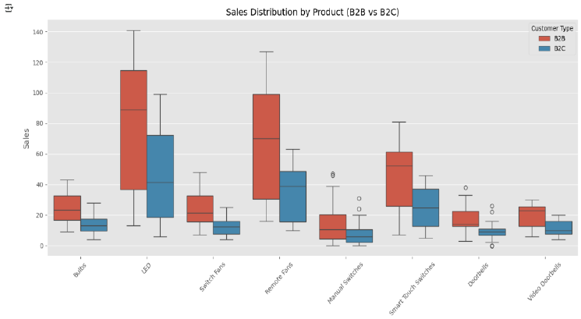
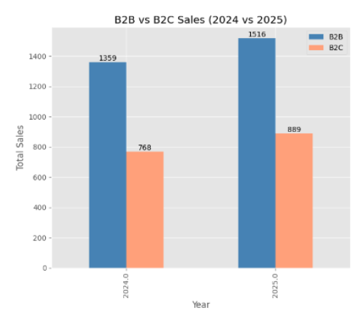
Results and Findings
7
The forecasting model was first validated on actual 2024 sales data (RMSE = 7.28 units) and then used to generate reliable sales projections for 2025
A boxplot is selected to display the spread, variability, and outliers in sales for each product and segment, which cannot be seen in average-based charts.
The plot shows that LEDs and remote fans have high, consistent demand (long boxes, higher medians), while older products exhibit greater variability and seasonal spikes, especially in B2C.
This analysis helps the business optimize stock levels, focus on reliable revenue drivers, and prepare for unpredictable demand in legacy products, especially during festival seasons.
A bar chart is chosen for its effectiveness in comparing sales volumes between B2B and B2C segments side-by-side across two years.
The chart shows that B2B sales remain higher, but B2C sales are growing at a faster rate (13.6% vs 10.3%), narrowing the gap between the two segments.
This reveals that while institutional buyers still dominate in volume, consumer adoption is accelerating, suggesting a strategic opportunity to expand B2C marketing and retail initiatives.

Slide 8
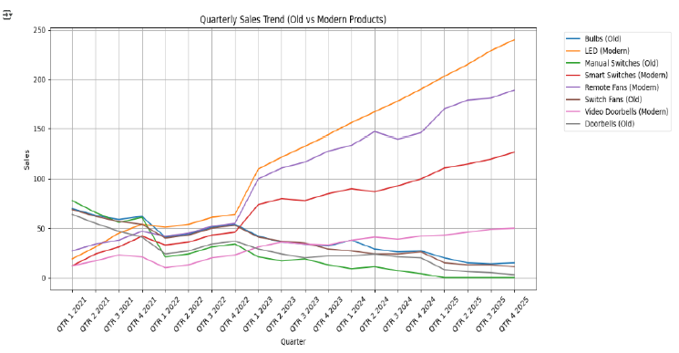
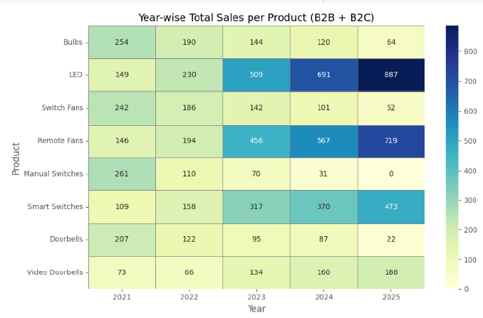
Results and Findings
8
A line chart is used to clearly visualize how sales of old-generation and modern products have changed over time, making trends and turning points easy to spot.
The graph shows that sales for old products steadily decline while modern products display sustained growth, especially after 2022, with a widening gap projected through 2025.
This trend highlights a fundamental shift in customer demand toward smart, energy-efficient products, signaling that the business should prioritize modern inventory and phase out legacy stock.
A boxplot is used here to compare the spread and consistency of sales for each product and channel, making it easy to see which items have steady demand and which show more irregular patterns.
This distribution confirms that LEDs are the shop’s highest-volume and most consistently demanded product, requiring careful bulk inventory management, while products like doorbells and switches have lower, more variable sales, often spiking only during seasonal or promotional periods.T
This analysis helps the business optimize stock levels, focus on reliable revenue drivers, and prepare for unpredictable demand in legacy products, especially during festival seasons.

Slide 9

Interpretation and Recommendations
9
Interpretation of Findings
Forecasts from 2024 to 2025 show old product sales (bulbs, manual switches, switch fans, doorbells) are projected to decline by ~35%, while modern products (LEDs, smart switches, remote fans, video doorbells) are expected to rise by ~27%.
B2B sales remain higher in volume but are forecasted to grow by 10.3%, whereas B2C sales are set to grow faster at 13.6%, narrowing the gap and signaling rising consumer demand.
LEDs are consistently the highest-volume product, with a much wider sales distribution than doorbells or switches, confirming the need for bulk inventory and robust stocking strategies.
The 2022 "Monday Off" policy led to a quantifiable sales dip of over 20% in Q1 and Q2, with recovery and seasonal peaks in Q3/Q4, especially during major festivals.
Actionable, Data-Driven Recommendations
Inventory Optimization: Reduce traditional bulb and manual switch stock by at least 30% and increase LED and smart switch inventory by 25–30% to match forecasted demand.
Phased-Out Products: Maintain only 5–10% of previous stock levels for legacy items to serve residual and replacement needs, minimizing deadstock.
B2C Focus: Expand B2C marketing and online presence to capitalize on the faster growth rate; run targeted promotions for smart products.
Festival-Driven Stocking: Analyze historical Q3/Q4 sales to set higher inventory thresholds for LEDs and remote fans during Diwali and Ganpati, ensuring no stockouts during peak demand.
Workforce Planning: Implement predictive scheduling and consider hiring or training skilled staff for inventory and data management, reducing operational disruptions during holidays or peak seasons.
Model Monitoring: Regularly validate and update the forecasting model with new sales data each quarter to ensure continued accuracy and adapt to market shifts.
2024 Validation
2025 Forecast
Data-Driven Actions/Expansion

Slide 10



Conclusion and Next Steps
10
Project Impact
Developed a robust, validated forecasting model for Mahavir Enterprise (average RMSE = 7.28 on 2024 data), enabling Mr. Vijay Singh Rajput to plan 2025 sales and inventory with high accuracy.
Identified a decisive market shift:
Old product sales (bulbs, manual switches, switch fans, doorbells) projected to decline by ~35% from 2024 to 2025.
Modern product sales (LEDs, smart switches, remote fans, video doorbells) forecasted to increase by ~27% in the same period.
B2C sales are growing faster than B2B (13.6% vs 10.3%), highlighting the need for Mahavir Enterprise to strengthen retail and digital marketing efforts.
Enabled data-driven actions for Mahavir Enterprise:
Reduce traditional stock by 30%, increase LED/smart switch inventory by 25–30%, and maintain only 5–10% stock for phased-out products.
Proactively plan for festival-season demand, using historical Q3/Q4 data to set higher inventory thresholds for LEDs and remote fans.
Align workforce scheduling and hiring/training with forecasted demand peaks, especially during festivals and holidays.
Next Steps
Update sales forecasts quarterly with new data and involve all teams in regular review to ensure strategies stay aligned with fickle market trends.
Pilot advanced analytics and digital marketing to further grow B2C sales and respond swiftly to changing consumer preferences.
THANK YOU

